Slide 1

Introduction to Tree Data Structures

Slide 2
What is a Tree Data Structure
A tree data structure is a hierarchical structure that is used to represent and organize data in a way that is easy to navigate and search.
It’s a non linear Data Structure
It’s faster to search for data than a linked list and an array.
Organizes Data better than array and linked list

Slide 3
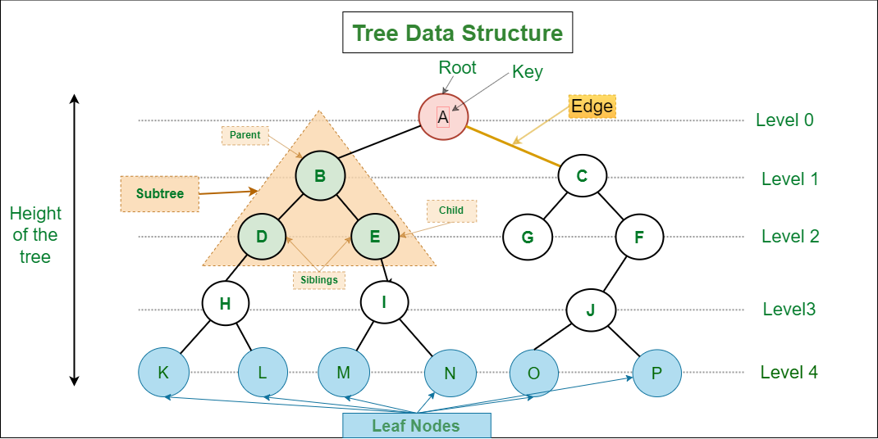

Slide 4
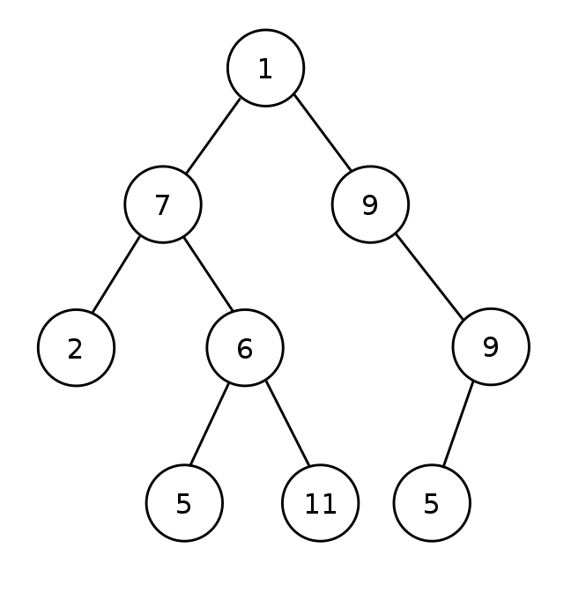
Binary Tree
A Binary tree is a tree data structure where each node has at most two children, referred to as the left child and the right child

Slide 5
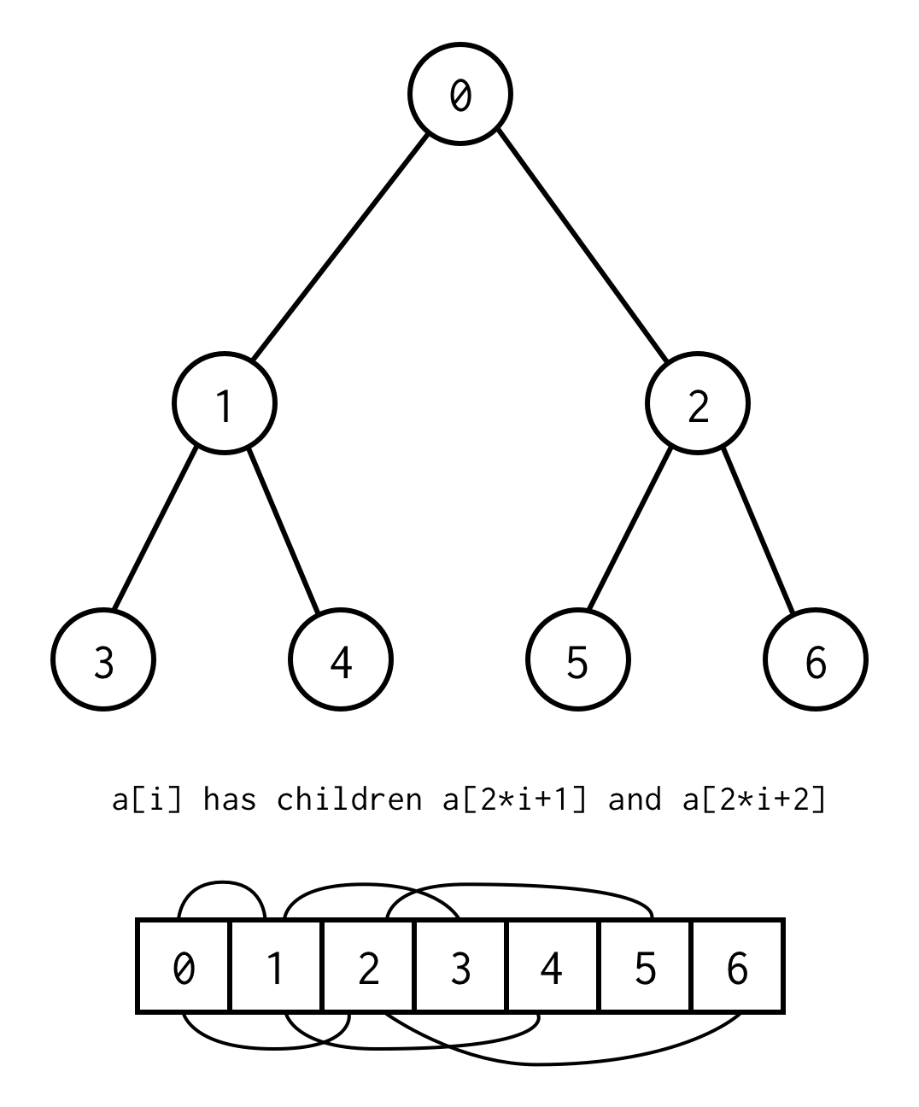

Slide 6
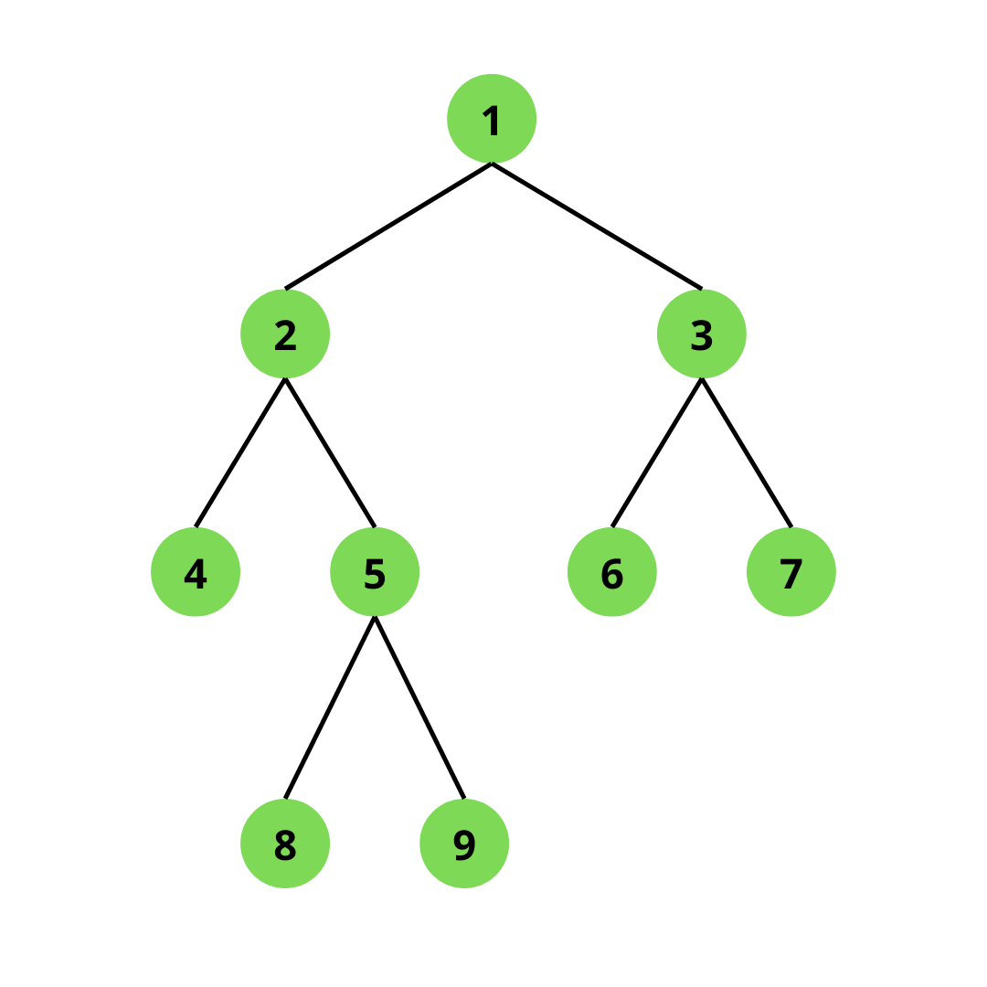
Strict/Full Binary Tree
A strict binary tree is a type of binary tree in which every node has exactly two children, except for the leaf nodes (which have no children).

Slide 7
Strict/Full Binary Tree Example

Slide 8
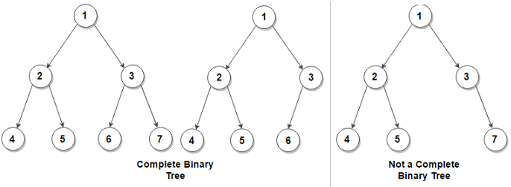
Complete Binary Tree
A complete binary tree is a binary tree in which every level of the tree is completely filled, except possibly for the last level, which is filled from left to right.

Slide 9
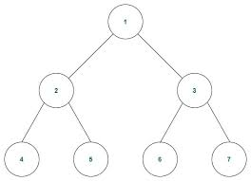
Perfect Binary Tree
A perfect binary tree is a binary tree in which all interior nodes have two children, and all leaf nodes are at the same depth or level.

Slide 10
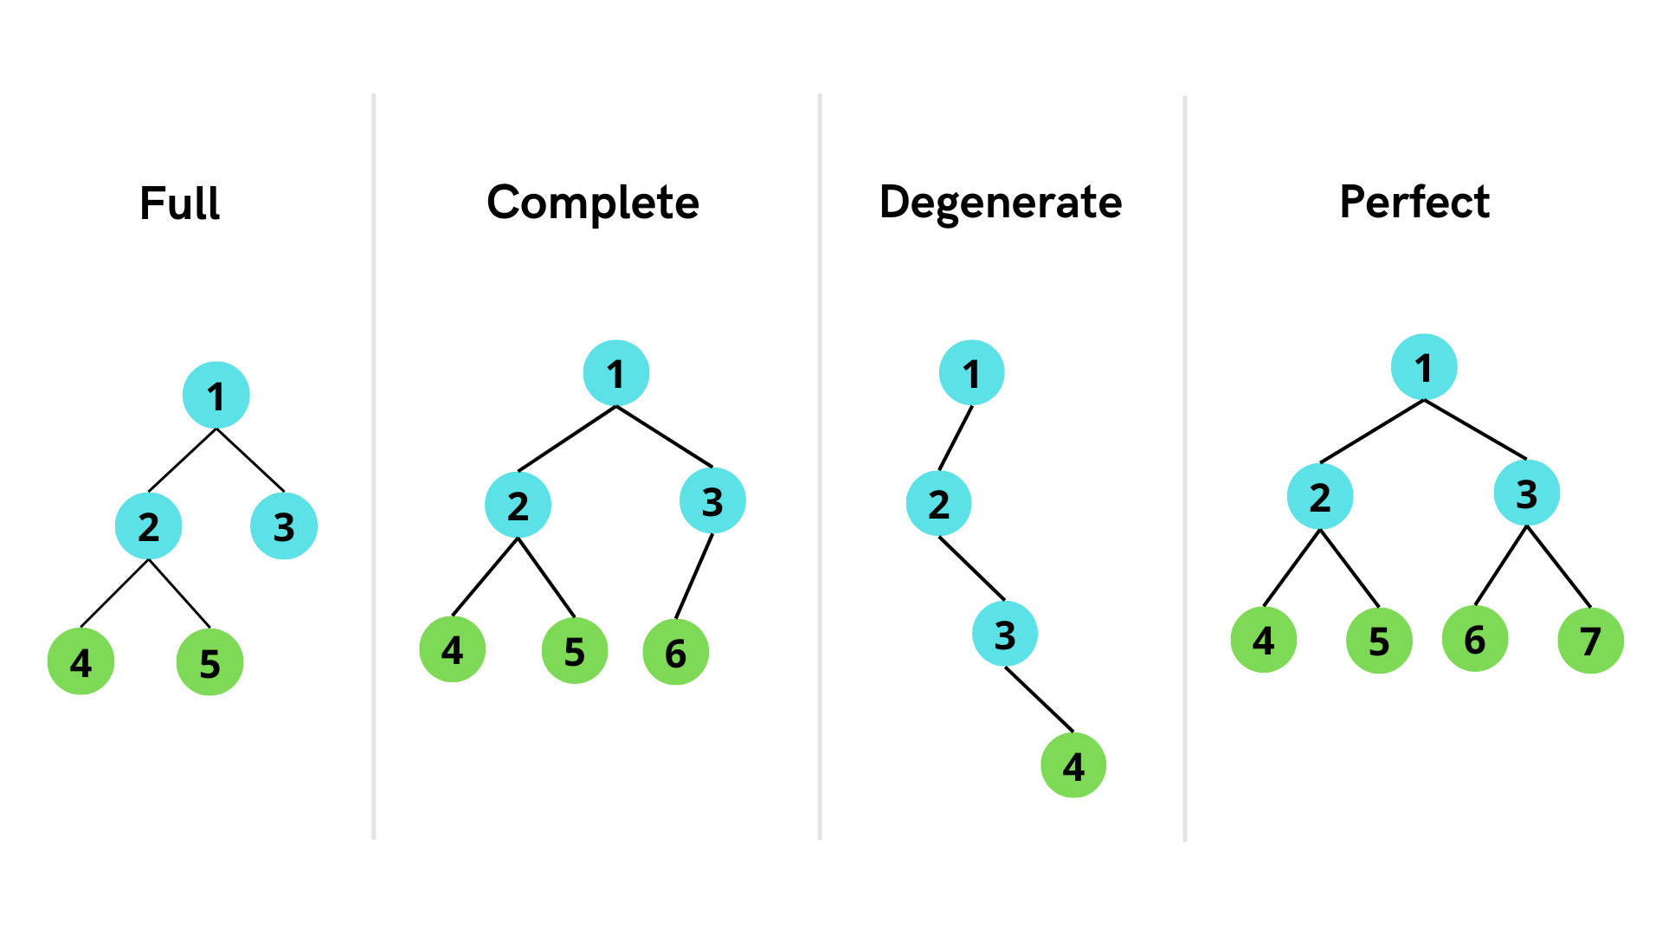

Slide 11
Binary Search Tree
A binary search tree is a binary tree data structure in which the value of each node is greater than or equal to the values of all the nodes in its left subtree and less than or equal to the values of all the nodes in its right subtree.
Binary Search Tree is a binary tree

Slide 12
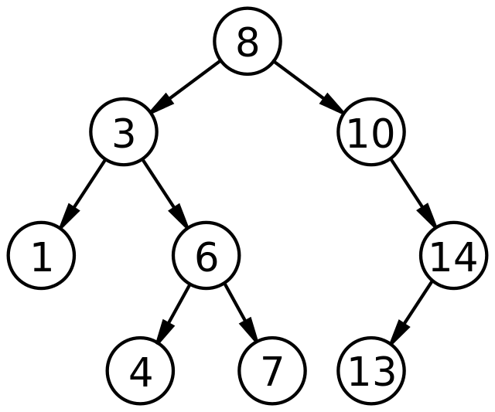
Binary Search Tree

Slide 13
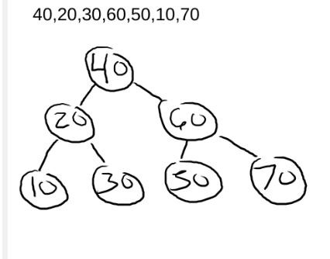
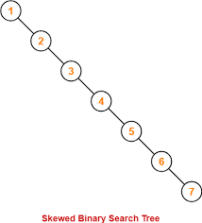
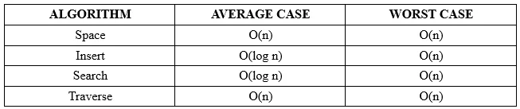
Time complexity of BST
Insert:1,2,3,4,5,6,7

Slide 14
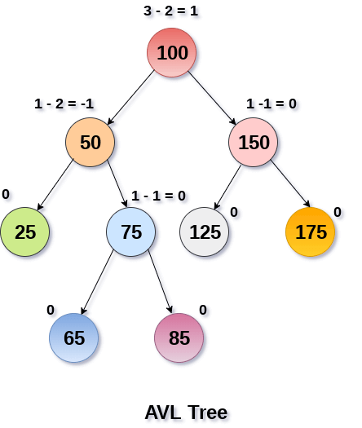
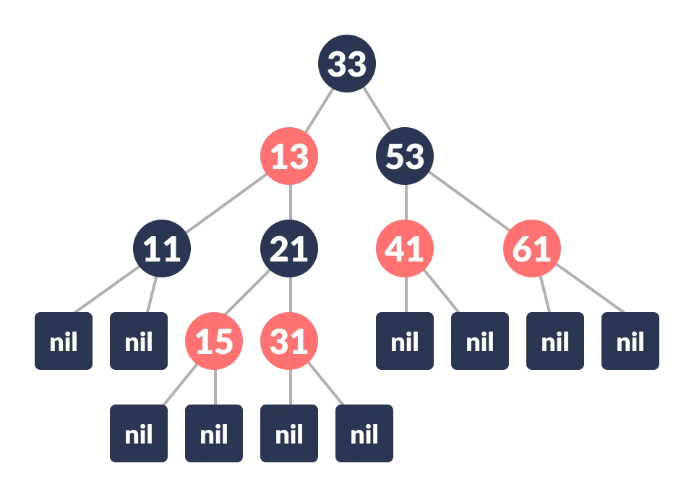
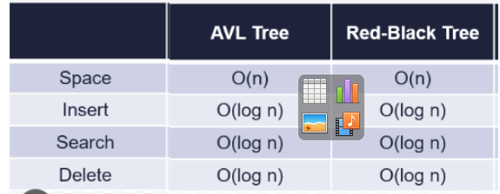
Self Balancing BST Trees
AVL
Red and Black

Slide 15
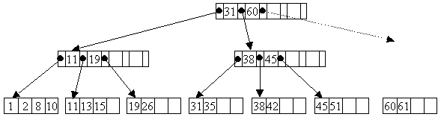
B-TREE
A B-tree is a self-balancing tree data structure that can store multiple values per node and is designed to reduce the number of disk accesses required to locate a particular piece of data, making it efficient for use in file systems and databases.

Slide 16
Thank you for watching

